Slide 1
Offboard Processing (Raspberry Pi and Ardiuno)
Jim Wright
The Whidbey Island Wild Cats 2980

Slide 2
This Workshop is on my Github
https://github.com/JimWright4089/FIRSTWorkshops/FRC/2022
https://github.com/JimWright4089/FIRSTWorkshops

Slide 3
This Workshop is on the Web
Workshop:
https://github.com/JimWright4089/FIRSTWorkshops/FRC/2022
Code:
https://github.com/JimWright4089/FIRSTRobots
Web:
https://jimwright.org/robot/robots.html
https://github.com/JimWright4089/FIRSTWorkshops

Slide 4
The Workshop Robot Code
The robot in this demo is name the Tornado Platypus
On the code github there are a bunch of sub directories to pay attention to
TornadoPlatypus
Arduino
Feather
JetsonNano
RaspberryPi
https://github.com/JimWright4089/FIRSTWorkshops

Slide 5
The Map!
What is the Hardware
Connecting it into a FRC robot
Standalone Things
WPI Raspberry Pi Image
Ubuntu setup
OpenCV/NTCore/Apriltags
I2C comm to 32bit processor
https://github.com/JimWright4089/FIRSTWorkshops

Slide 6
What is the Hardware
Raspberry Pi type things (Heavy Processors)
8 Bit processors
32 Bit processors
https://github.com/JimWright4089/FIRSTWorkshops

Slide 7
Heavy Processors
What are they, how are they used.
Pros:
Heavy Communication Lifters (WPI Net Tables)
Heavy Processing
Mostly Linux
Cons:
Timers, Linux is bad at LED Strips
Analog Reading/Writing
Big, takes lots of power.
Expensive/Hard to get right now
Mostly Linux
https://github.com/JimWright4089/FIRSTWorkshops

Slide 8
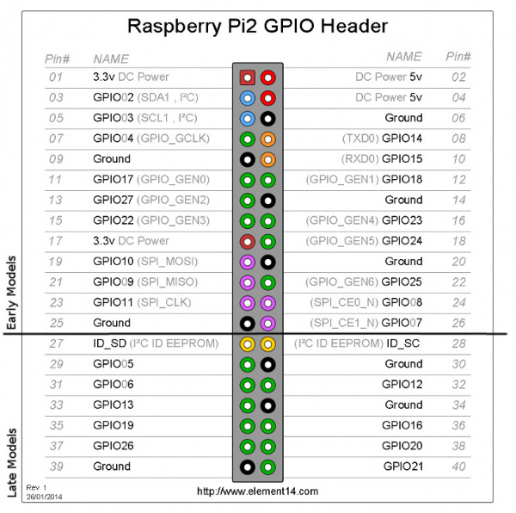
Heavy Processors Raspberry Pi type things
Standard Pin out, therefore lots of “hats” for them
Most of them are 5V, draws 2Amps – 5Amps, depending on what you have connected to them.
The pins are 3 volt!!!!! ← Oh, so important
They get hot, heatsink cases are needed.
https://github.com/JimWright4089/FIRSTWorkshops

Slide 9
Heavy Processors Raspberry Pis
Raspberry Pi 4 (Rpi4)
Comes with 1Gb, 2Gb, 4Gb, and 8Gb SRAM
Micro-HDMI ports
Lots of documentation on the Web for these.
Cases are incompatible with Rpi 3, 2, 1
https://github.com/JimWright4089/FIRSTWorkshops

Slide 10
Heavy Processors Raspberry Pis
Raspberry Pi 3 (Rpi3)
Comes with 1Gb, 2Gb, 4Gb SRAM
Full size HDMI ports
Harder to buy, however, most everyone has one of them lying about.
Lots of documentation on the Web for these.
Minimum device for FRC Offboard processing.
https://github.com/JimWright4089/FIRSTWorkshops

Slide 11
Heavy Processors Raspberry Pis
Raspberry Pi Zeros
Two variants
Raspberry Pi Zero - Version 1.3
Raspberry Pi Zero W (Wifi)
Full size HDMI ports
No Eithernet port
One usable USB port, to Usb Hub is needed.
There power the Limelights (I’ve been told)
https://github.com/JimWright4089/FIRSTWorkshops

Slide 12
Heavy Processors NVIDIA Jetson Nano
Raw Processing power is between Rpi 3 and Rpi4.
Basically a NVIDIA graphics card strapped to a Rpi
Good for Vision Processing and Machine Learning.
A lot more software expertise is needed to really make ‘em run.
https://github.com/JimWright4089/FIRSTWorkshops

Slide 13
Heavy Processors Jetson AGX Xavier/Orin Nano
AGX Xavier at $1,300 you can’t use it on an FRC Bot
I just include it because this is what Professional Robotics Engineers use.
Orin Nano is just coming out there isn’t a lot of information on it.
https://github.com/JimWright4089/FIRSTWorkshops

Slide 14
Heavy Processors Google Coral Dev Board
Raw Processing power is between Rpi 3 and Rpi4, less than the Jetson Nano.
Good for Machine Learning.
A board built for Tensor Flow
A lot more software expertise is needed to really make ‘em run.
Good enough for Vision Processing
https://github.com/JimWright4089/FIRSTWorkshops

Slide 15
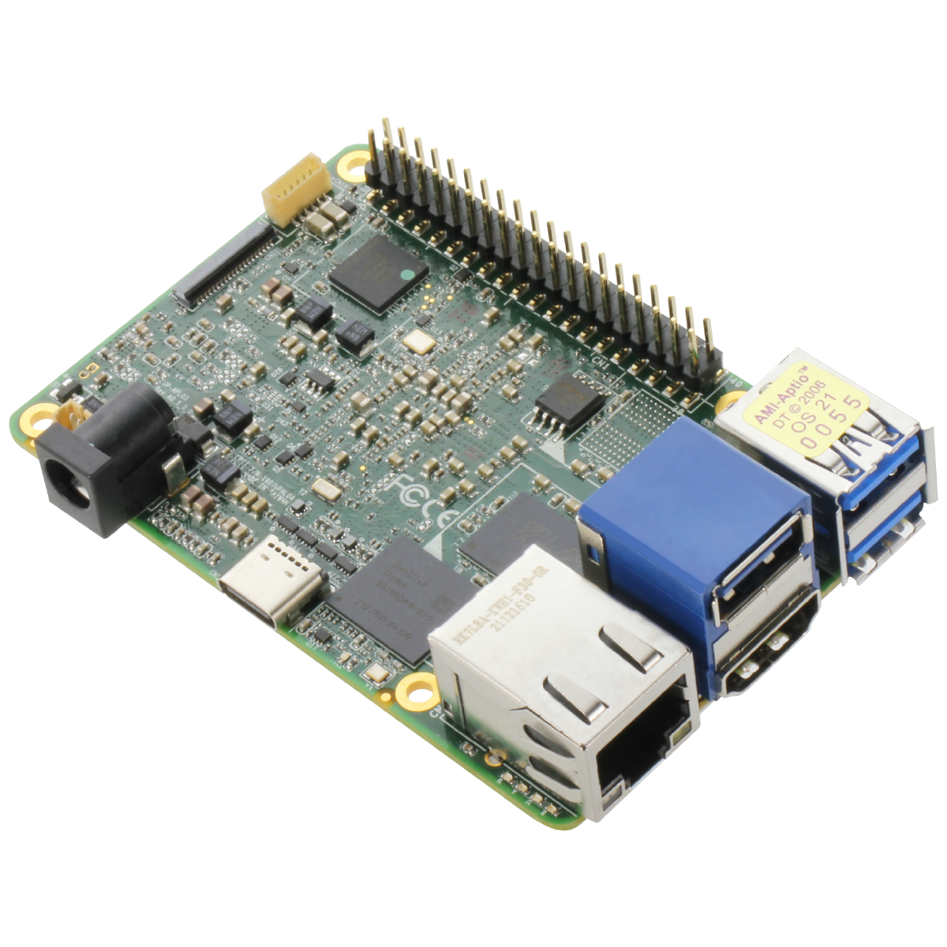
Heavy Processors UP 4000
Intel Based
Built for Windows IoT
I have one but I’ve not had much time with it.
You can get them reliably now but pricey
12 Volt Based 5Amp!!
https://github.com/JimWright4089/FIRSTWorkshops

Slide 16
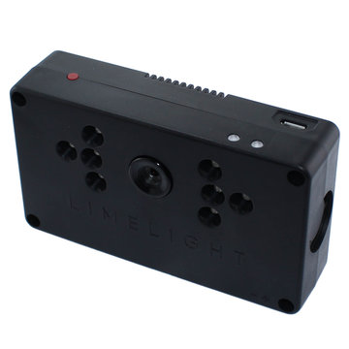
Heavy Processors Limelight
It’s odd to put the Limelight in this section. It really is a Rpi Zero.
Since we are switching from Reflective Tape on the field to Apriltags, I’m guessing teams are working on switching these over.
Most teams own these. So there FREE!!!
I’m hoping for a new firmware release to include the April Tag library.
https://github.com/JimWright4089/FIRSTWorkshops

Slide 17
Jim’s Raspberry Pi 4 favorite cases
Big ‘ol chunk of Alluminum
Fans that use the 5V pins
https://www.adafruit.com/product/4340
Non-fan heat sink cases come in various colors.
The non-fan cases look like they are being discontinued, but I’m not sure if that might be a part-shortage issue.
https://github.com/JimWright4089/FIRSTWorkshops

Slide 18
Arduino type things Both 8bit and 32bit
The concept of an Arduino was game changing in the Embedded world.
Before Arduino Embedded Engineers had to write low level device drivers from scratch every time.
The Arduino IDE is sooo game changing.
A lot of code is written, and a lot of boards use the IDE.
https://github.com/JimWright4089/FIRSTWorkshops

Slide 19

Arduino type things 8 - bit
The UNO “family” is the most popular.
These are the standard pin outs for 8 – bit processors.
Lot and Lots of “hats” for these.
They are meant for very simple very specific applications.
Not that useful for FRC anymore.
Accepts 5 Volts, pins are 5 Volts.
This is critical for LED strip applications.
https://github.com/JimWright4089/FIRSTWorkshops

Slide 20
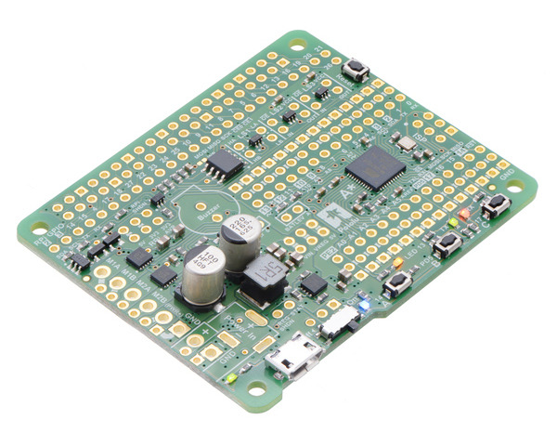
Arduino type things Pololu A-Star 32U4
Pololu A-Star drivers need to be added to the Arduino IDE (more on that later).
I (Jim) considers this the most important FRC off board device.
It’s a Raspberry PI Hat with a UNO built in. So it can source both 5V and 3.3V pins.
The 5V to 3.3V level shifters are built into the I2C lines.
It has a 12V to 5V regulator on it, you can wire it into the PDP/PDH safely
https://www.pololu.com/product/3118
https://github.com/JimWright4089/FIRSTWorkshops

Slide 21
Arduino type things 32 - bit
These have taken over the small processor space.
They are faster with more RAM and Flash (programming capacity).
Most sensors are now being designed for these.
5V in, however like the Rpis 3.3V pins.
SparkFun's Qwiic Connect plugs are quickly becoming standard and they make wiring thing easy. (These are I2C at the low level)
All processors use the Arduino IDE
https://github.com/JimWright4089/FIRSTWorkshops

Slide 22
Arduino 32bit type things Adafruit Feather Family
ATSAMD21 Cortex M0
256KB of FLASH + 32KB of RAM
48MHz with 3.3V logic/power
ATSAMD51 Cortex M4
512 KB flash, 192 KB RAM
120 MHz, 32-bit, 3.3V logic and power
I (Jim) use these for LED matrix drivers.
Adafruit has ‘hats’ for these.
https://github.com/JimWright4089/FIRSTWorkshops

Slide 23
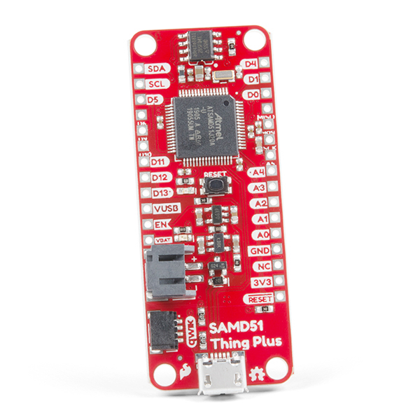
Arduino 32bit type things SparkFun Thing Plus - SAMD51
It’s a M4 processor.
This has the Qwiic connector built in.
I (Jim) use these for driver station buttons.
https://github.com/JimWright4089/FIRSTWorkshops

Slide 24
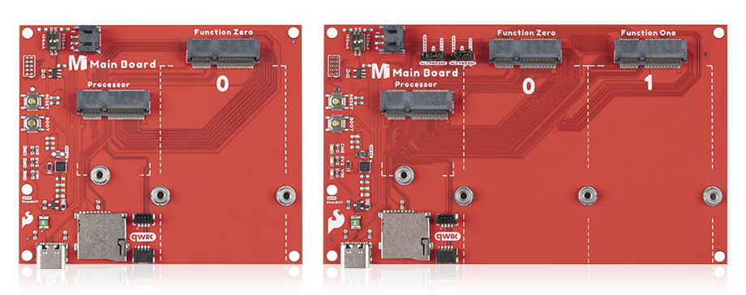
Arduino 32bit type things SparkFun MicroMod system
Weird idea, any processor wired into a bunch of peripherals.
Easy wire, secure
https://github.com/JimWright4089/FIRSTWorkshops

Slide 25
The Map!
What is the Hardware
Connecting it into a FRC robot
Standalone Things
WPI Raspberry Pi Image
Ubuntu setup
OpenCV/NTCore/Apriltags
I2C comm to 32bit processor
https://github.com/JimWright4089/FIRSTWorkshops

Slide 26
Connecting it into a FRC robot The Rules
R503
With the exception of servos, fans, or motors integral to sensors of COTS computing devices permitted in R501, each actuator must be controlled by a power regulating device. The only power regulating devices for actuators permitted on the ROBOT include:
Basically, the RoboRio MUST controls ALL actuators (even servos).
Off board devices are sensors and LED status/decoration things.
https://github.com/JimWright4089/FIRSTWorkshops

Slide 27
Connecting it into a FRC robot
With the exception of the UP 4000, all of the previous devices take in 5 volts.
The 8bit and 32bit boards can be powered off of the 5V ports of the VRM, or USB ports of the driverstation laptop.
The Heavy Processors however, are creeping above the 2Amp limit of the VRM
https://github.com/JimWright4089/FIRSTWorkshops

Slide 28
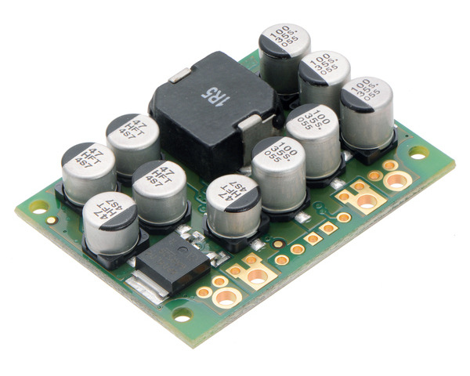
Connecting it into a FRC robot Getting power to ‘em
Pololu has an amazing assortment of 12V to 5V converters.
Pololu 5V, 15A Step-Down Voltage Regulator D24V150F5
https://www.pololu.com/product/2881
12V lines come from the PDP/PDH
5V lines come out of it
https://github.com/JimWright4089/FIRSTWorkshops

Slide 29
Connecting it into a FRC robot The Rules/Pro Tip
R624
All non-SIGNAL LEVEL wiring with a constant polarity (i.e., except for outputs of relay modules, motor controllers, or sensors) shall be color-coded along their entire length from the manufacturer as follows:
A. red, yellow, white, brown, or black-with-stripe on the positive (e.g. +24VDC, +12VDC, +5VDC, etc.) connections
B. black or blue for the common or negative side (-) of the connectionsBasically, the RoboRio MUST controls ALL actuators (even servos).
My company (Astronics) has a unwritten rule that, all Aircraft Power (28Volt usually) is Red/Black. All 5V power is Orange/Black so they don’t mix.
I would suggest Yellow/Blue for your 5V power bus.
https://github.com/JimWright4089/FIRSTWorkshops

Slide 30

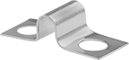
Connecting it into a FRC robot 5V Power Bus
Anderson Quick Connects come in other colors than Red/Black.
https://powerwerx.com/anderson-powerpole-colored-housings
Anderson Quick Connect Bus
https://powerwerx.com/8-position-powerpole-distribution-block
Terminal Blocks
From McMaster or most local Hardware Stores
McLendon Hardware has a good selection
Termal Block Jumpers
https://github.com/JimWright4089/FIRSTWorkshops

Slide 31
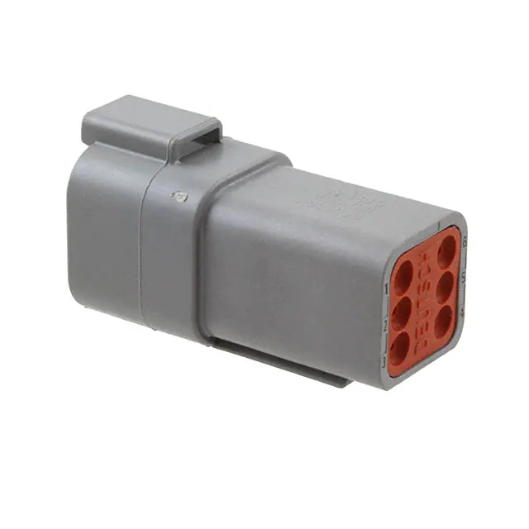
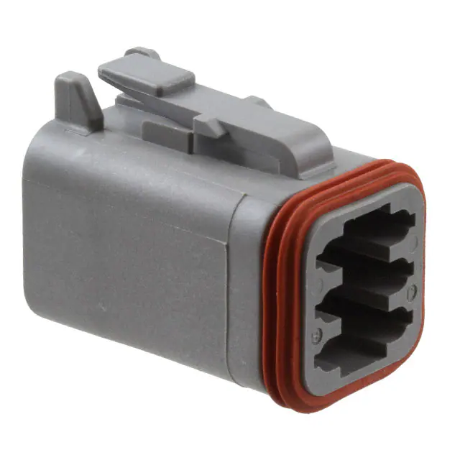
Connecting it into a FRC robot TE Con Deutsch Connectors
Digikey sells the best selection
Part Numbers for the 6 pin.
DT04-6P – Socket Shell
W6P – Wedge Lock
DT06-6S – Plug Shell
W6S – Other Wedge Lock
0462-201-16141 Socket Pin
0460-202-16141 Pin
Crimp tool is expensive on Digikey. Cheaper one:
https://www.customconnectorkits.com/902-499/
https://github.com/JimWright4089/FIRSTWorkshops

Slide 32

Connecting it into a FRC robot Control System
All the processing needs to go through the RoboRio everything needs to attach to it.
Heavy Processors connect through Ethernet and talk Net Tables (NTCore).
8bit and 32bit could talk I2C, however, the RoboRio I2C port is ‘SUS’
8bit and 32bit can connect to the digital IO or the serial port.
However, it’s convenient to have the 8bit and 32bit talk to the Heavy Processors and have them talk NTCore
The 32bit processors can talk Ethernet, however, compiling NTCore for them is a problem. If WPI would switch to the MQTT protocol this problem would be solved.
https://github.com/JimWright4089/FIRSTWorkshops

Slide 33
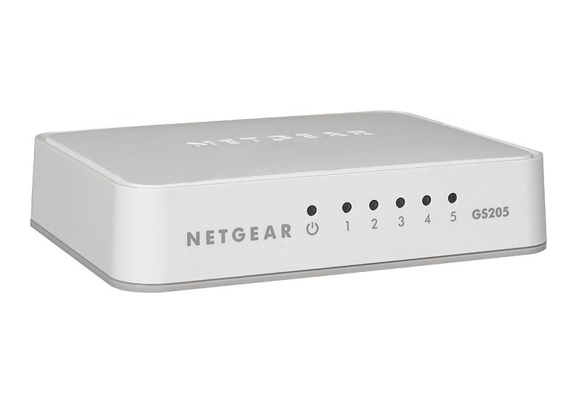
Connecting it into a FRC robot Control System
The Ethernet on the robot is getting crowded.
Adding a switch to the robot is a good idea.
The lightest switch I (Jim) have found is the NETGEAR 5-Port Gigabit Ethernet Unmanaged Switch (GS205) or the non-Gigabit switch (FS205)
It takes 12V power and can be plugged into the VRM
https://github.com/JimWright4089/FIRSTWorkshops

Slide 34
Connecting it into a FRC robot Control System
Rpi4 with Pololu Hat
12V cables soldered into the power plugs.
The FAN in the case run off 5V so the 5V and ground lines run to the plug.
There is a cable for LED Ring
https://github.com/JimWright4089/FIRSTWorkshops

Slide 35
Connecting it into a FRC robot Control System
Rpi4 with Qwiic connector on it.
5V supply
This case doesn’t have fans
https://github.com/JimWright4089/FIRSTWorkshops

Slide 36
Connecting it into a FRC robot Control System
Raspberry Pis take a lot of amps.
If the Pi is not getting enough current it will show it on the display.
Wire your Pi into robot and plug it into a display.
Turn the robot on.
If the Pi is not getting enough current a lightning bolt will appear in the upper right corner.
If it’s there you need to put a bigger power converter on your robot.
https://github.com/JimWright4089/FIRSTWorkshops

Slide 37
The Map!
GET UP AND STRETCH
What is the Hardware
Connecting it into a FRC robot
Standalone Things
WPI Raspberry Pi Image
Ubuntu setup
OpenCV/NTCore/Apriltags
I2C comm to 32bit processor
https://github.com/JimWright4089/FIRSTWorkshops

Slide 38
The Map!
What is the Hardware
Connecting it into a FRC robot
Standalone Things
WPI Raspberry Pi Image
Ubuntu setup
OpenCV/NTCore/Apriltags
I2C comm to 32bit processor
https://github.com/JimWright4089/FIRSTWorkshops

Slide 39
Standalone Things Examples
The Whidbey Island Wildcats
Feather M4 based
32X64 LED Matrix
Stealth Driver Station Button Board
Thing Plus - SAMD51
Arcade Buttons
Qwiic Encoders
Adafruit LED Rings
https://github.com/JimWright4089/FIRSTWorkshops

Slide 40
Standalone Things Arduino IDE
IDE can be found here: https://www.arduino.cc/en/software
At start the IDE only has Arduino boards
On Preferences click on the browse button for the Additional Board Manager
Find the URL on the board makers Web site and add it.
https://github.com/JimWright4089/FIRSTWorkshops

Slide 41
Standalone Things Arduino IDE
There is a Library for almost any device you can buy on Pololu, Sparkfun, or Adafruit.
Under Tools click on manager library and then search for the library
https://github.com/JimWright4089/FIRSTWorkshops

Slide 42
Standalone Things Arduino IDE
Plug the device in and Windows should recognize it.
Under tools you should be able to select the device you are working with.
Find the Com port in the Device Manager
The select that COM port
Test everything is working using the Blink Example, every board should have the blink LED.
https://github.com/JimWright4089/FIRSTWorkshops

Slide 43
Standalone Things Wildcats Robot Googly Eyes
2980 had a set of googley eyes on their robot.
Feather M4 based
https://www.adafruit.com/product/3857
32X64 LED Matrix
https://www.adafruit.com/product/2279
Feather LED Matrix Hat
https://www.adafruit.com/product/3036
Pololu 12V to 5V stepdown converter
https://www.pololu.com/product/3782
Code
https://github.com/JimWright4089/FIRSTRobots/tree/master/Code/Feather/RobotEyes
https://github.com/JimWright4089/FIRSTWorkshops

Slide 44
The Map!
What is the Hardware
Connecting it into a FRC robot
Standalone Things
WPI Raspberry Pi Image
Ubuntu setup
OpenCV/NTCore/Apriltags
I2C comm to 32bit processor
https://github.com/JimWright4089/FIRSTWorkshops

Slide 45
WPI Raspberry Pi Image What is it
WPI, maker of the WPI lib we all use have a Raspberry Pi image of the OS with NTCore, Camera Server, OpenCV in a package.
https://github.com/wpilibsuite/WPILibPi/releases
Download the WPILibPi_image-v2022.1.1.zip
https://github.com/JimWright4089/FIRSTWorkshops

Slide 46
WPI Raspberry Pi Image Buring Flash
The OS for a Rpi is on a SD card.
To build this card use the Raspberry Pi Imaging tool
https://www.raspberrypi.com/software/
Unzip the zip file, choose custom image in the tool, then plug in a micro SD card (and it’s adaptor) into your computer and select the card.
Hit Write.
https://github.com/JimWright4089/FIRSTWorkshops

Slide 47
WPI Raspberry Pi Image Pi Image Pro Tip
Since SD cards are the hard drives for a Rpi, you can swap them easily.
It becomes hard to figure out which SD card is which image.
On the back of SD cards I paint a little pattern.
I have a Google Docs File of the color pattern and which image it is.
https://github.com/JimWright4089/FIRSTWorkshops

Slide 48
WPI Raspberry Pi Image OS is locked
Plug the SD card into the Pis SD card port.
Connect up an ethernet, webcam, display and keyboard.
On boot up the user is ‘pi’ and password is ‘raspberry’
The prompt will end in a (RO), which indicates the OS is in read only.
Use ‘ifconfig’ to see the IP address.
Type the IP address into a web browser.
https://github.com/JimWright4089/FIRSTWorkshops

Slide 49
WPI Raspberry Pi Image Web Page
The first page is just status, however, at the top of the page are the Read Only/Write buttons.
On the Vision Setting is the box to enter your team number. Set the system to write and hit save.
On this Panel you can see what the camera is seeing.
https://github.com/JimWright4089/FIRSTWorkshops

Slide 50
WPI Raspberry Pi Image SSH
https://github.com/JimWright4089/FIRSTWorkshops

Slide 51
WPI Raspberry Pi Image Color blob Example
The Application tab of the web page will let you build your OpenCV pipeline.
Download the example from the bottom buttons
I’m a C++ programmer so I will use C++, it is homework for you to figure out Java
https://github.com/JimWright4089/FIRSTWorkshops

Slide 52
WPI Raspberry Pi Image Color blob Example
Code is located at:
https://github.com/JimWright4089/FIRSTRobots/tree/master/Code/RaspberryPi/cpp-multiCameraServer
Explanation of the code:
http://jimwright.org/robot/ri3d2020/raspberrypi.html
https://github.com/JimWright4089/FIRSTWorkshops

Slide 53
WPI Raspberry Pi Image Color blob Example
Upload the zip file you just downloaded.
On the command line unzip the file unzip cpp-multiCameraServer.zip.
On the application page upload the file main.c.
On the Rpi the main.c file will appear in the home directory.
Move it to the example directory with
mv main.cpp ./cpp-multiCameraServer/
https://github.com/JimWright4089/FIRSTWorkshops

Slide 54
WPI Raspberry Pi Image Color blob Example
If you are building on the Rpi, you need to change the Makefile.
nano Makefile
Change the line:
CXX=arm-raspbian10-linux-gnueabihf-g++
To
CXX=g++
Run ‘make’
Run ‘make install’
Run ‘sudo svc -t /service/camera’
https://github.com/JimWright4089/FIRSTWorkshops

Slide 55
WPI Raspberry Pi Image Color blob Example
https://jimwright.org/robot/ri3d2020/raspberrypi.html
https://github.com/JimWright4089/FIRSTWorkshops

Slide 56
WPI Raspberry Pi Image Color blob Example
If the Rpi is on you desk, put it on the robot, you will not need the Display and Keyboard any more.
Finding the IP address is a bit painful.
From Command line ssh to the RoboRio ‘ssh admin@10.40.89.2’
Once you’re in the RoboRio ‘ping wpilibpi’
The IP address should be shown and type that into the browser address.
https://github.com/JimWright4089/FIRSTWorkshops

Slide 57
WPI Raspberry Pi Image Color blob Example
On the Vision Status, you can turn the print statements on and see what is happening.
https://github.com/JimWright4089/FIRSTWorkshops

Slide 58
WPI Raspberry Pi Image Color blob Example
The default dashboard should have two cameras on it.
Processed
Threashold
https://github.com/JimWright4089/FIRSTWorkshops

Slide 59
The Map!
What is the Hardware
Connecting it into a FRC robot
Standalone Things
WPI Raspberry Pi Image
Ubuntu setup
OpenCV/NTCore/Apriltags
I2C comm to 32bit processor
https://github.com/JimWright4089/FIRSTWorkshops

Slide 60
Ubuntu setup Raspberry PI Imaging tool
We have seen this tool already.
We need to decide which image to put on.
Ubuntu
A large amount of help is available. Anything but a Rpi this really is the only thing available.
Raspberrian 64bit for sure
Lite does not have the desktop.
If you have used Raspberrian already use this. It’s a it faster since there isn’t a UI on it.
OS with desktop
A good place to begin because you can always connect a display to it to see what is going wrong.
https://github.com/JimWright4089/FIRSTWorkshops

Slide 61
Ubuntu setup Desktop/Command Line
On the first boot you need to set it up.
Rpi is designed in the United Kingdom, so everything is set for UK.
Change to USA, select timezone
SELECT US KEYBOARD!!!!
Create a user, if your team has a standard log in use that.
Select WiFi
It will install updates
https://github.com/JimWright4089/FIRSTWorkshops

Slide 62
Ubuntu setup SSH
At this point we will do everything from the command line, so we could SSH to the box
Rpis have the SSH server turned off at the start so we need to turn things on.
Open a terminal (command line) window and type ‘sudo raspi-config’
In the interface panel, turn SSH on and I2C on.
Now we can SSH to the box if we know the IP address.
Type ‘ifconfig’ that will tell you the IP address
On you PC open a command line and type ‘ssh stealth@192.168.143.67’
https://github.com/JimWright4089/FIRSTWorkshops

Slide 63
Ubuntu setup APT
sudo apt install build-essential
You have just the operating system on the Pi so we need to install packages using the APT tool.
First type ‘sudo apt update’ this checks all of the repositories on the internet for updates to their list of packages.
Things to install
sudo apt install cmake
sudo apt install build-essential
sudo apt install git
sudo apt install default-jdk
sudo apt install libgtk2.0-dev
sudo apt install pkg-config
https://github.com/JimWright4089/FIRSTWorkshops

Slide 64
Ubuntu setup SSHFS
So far we have been SSHing to get to the command lines of things.
There is something called SSHFS. Which connects the file system of the Pi to your computer, and it will act like a shared drive.
Google SSHFS and install WinFsp and SHFS-Win.
Now you can map a network drive using \\sshfs\stealth@192.168.143.67
https://github.com/JimWright4089/FIRSTWorkshops

Slide 65
The Map!
What is the Hardware
Connecting it into a FRC robot
Standalone Things
WPI Raspberry Pi Image
Ubuntu setup
OpenCV/NTCore/Apriltags
I2C comm to 32bit processor
https://github.com/JimWright4089/FIRSTWorkshops

Slide 66
OpenCV/NTCore/Apriltags git cloning
OpenCV, Apriltags, and NTCore need to be built from source. In order to do this the source code needs to be on your Pi.
Under your home directory (cd ~) make a new directory call FRC. The command is ‘mkdir FRC’. Then change into it ‘cd F’ then hit the tab key then enter. Then clone three things.
git clone https://github.com/opencv/opencv.git
git clone https://github.com/AprilRobotics/apriltag.git
git clone https://github.com/wpilibsuite/allwpilib.git
https://github.com/JimWright4089/FIRSTWorkshops

Slide 67
OpenCV/NTCore/Apriltags building
Apriltags
Change into the apriltags directory.
Make a new directory called build
In build type ‘cmake ../’, then ‘make’, then ‘sudo make install’
Opencv is basically the same.
Change into the opencv directory.
Make a new directory called build
In build type ‘cmake ../’, then ‘make’, then ‘sudo make install’
This will take a long time
https://github.com/JimWright4089/FIRSTWorkshops

Slide 68
OpenCV/NTCore/Apriltags building
WPIlib
Change into the WPIlib directory.
Type ‘./gradlew build
This will take a long time
https://github.com/JimWright4089/FIRSTWorkshops

Slide 69
OpenCV/NTCore/Apriltags Jim’s Code
Create a directory under home called ‘code’
Git clone https://github.com/JimWright4089/FIRSTRobots.git
We will be using four directories
Code/RaspberryPi/opencv/displayimage
Code/RaspberryPi/opencv/basicviewer
Code/RaspberryPi/opencv/colorlocator
Code/RaspberryPi/opencv/apriltags_opencv_demo
https://github.com/JimWright4089/FIRSTWorkshops

Slide 70
OpenCV/NTCore/Apriltags Making and Running
If the following file/directories are there we need to clean them out
CMakeCache.txt, cmake_install.cmake, CMakeFiles
rm ./CMakeCache.txt
rm ./cmake_install.cmake
rm -rf ./CMakeFiles
Now run:
cmake ./
make
./displayimage ./OwlNeon500Circ.jpg
https://github.com/JimWright4089/FIRSTWorkshops

Slide 71
OpenCV/NTCore/Apriltags OpenCV Camera Viewer
Just to get a stream from a camera use basicviewer
https://github.com/JimWright4089/FIRSTWorkshops

Slide 72
OpenCV/NTCore/Apriltags Color Locator
This is a tool for looking at an image and just getting a chunk of it for a color.
https://github.com/JimWright4089/FIRSTWorkshops

Slide 73
OpenCV/NTCore/Apriltags Color Locator
Adjust the sliders to isolate the color that you want to capture.
These numbers will be put back into the WPI Raspberry Sample.
int mLow1Value = 0;
int mHigh1Value = 255;
int mLow2Value = 90;
int mHigh2Value = 226;
int mLow3Value = 214;
int mHigh3Value = 255;
https://github.com/JimWright4089/FIRSTWorkshops

Slide 74
OpenCV/NTCore/Apriltags Color Locator, Color Space
Uses a color space called HSV.
Most of us are use to RGB
HSV is
Hew – the color, like the reds, the yellows.
Satuaration – how close to the color is it, or how close to black is it.
V ????- I can’t remember is, but it’s how close to white it is.
https://github.com/JimWright4089/FIRSTWorkshops

Slide 75
OpenCV/NTCore/Apriltags April Tag Viewer
April Tags are a Fiducial type.
https://april.eecs.umich.edu/software/apriltag
FRC is going to use the tag16h5 ‘dictionary’
The first 30 of them can be located at https://github.com/AprilRobotics/apriltag-imgs
These are tiny images. Use a tool like photoshop to expand them to 8” by 8”
https://github.com/JimWright4089/FIRSTWorkshops

Slide 76
OpenCV/NTCore/Apriltags April Tag Viewer
The apriltags_opencv_demo demo is “noisy” You will get a bunch of false positives, so it will need a filter.
When the tag is found, the tool will draw a blue box around it, a green line on the top and red line on the right.
The lengths of the lines can tell how far away is the tag.
https://github.com/JimWright4089/FIRSTWorkshops

Slide 77
OpenCV/NTCore/Apriltags NT Core
Er, Um, Er, In 2019 WPI did a major rework of the WPI lib.
I had not tried to build my NT examples since then.
I’m close to getting them working on a non-WPI Image Rpi but I’m not going to have it finished by today.
It’s in the linker area, but I’m not sure what to link.
https://github.com/JimWright4089/FIRSTWorkshops

Slide 78
The Map!
What is the Hardware
Connecting it into a FRC robot
Standalone Things
WPI Raspberry Pi Image
Ubuntu setup
OpenCV/NTCore/Apriltags
I2C comm to 32bit processor
https://github.com/JimWright4089/FIRSTWorkshops

Slide 79
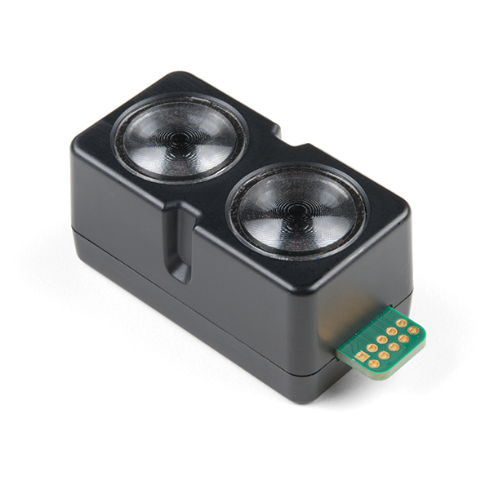
I2C comm to 32bit processor Raspbery Pi Sensors
Using an I2C sensor that was meant for a 32bit processor on a Rpi is fairly straight forward
Arduino Libraries are written in C++ and can be ported to Rpi
We will be looking at the Sparkfun Garmin LIDAR-Lite v4 sample.
https://github.com/JimWright4089/FIRSTWorkshops

Slide 80
I2C comm to 32bit processor Raspbery Pi Sensors
First using the Arduino IDE install the Sparkfun Garmin LIDAR-Lite v4 Library.
The Arduino Libraries are stored in your Documents Driectory under Arduino
Under that you will find a directory C:\Users\Jim\Documents\Arduino\libraries\SparkFun_Garmin_LIDAR-Lite_v4_Arduino_Library\src
Grab the two file and put them onto the Rpi (using SSHFS)
https://github.com/JimWright4089/FIRSTWorkshops

Slide 81
I2C comm to 32bit processor 32bit Side
Hardware
Pololu A-Star 32U4
Microsoft Life cam
Adafruit NeoPixel Ring - 16 x 5050 RGB LED
Open up the I2C port and read bytes
Each byte is a command to the ring
Commands
Off
Solid
Spin
Colors
White
Red
Blue
Green
Yellow
Magenta
Cyan
https://github.com/JimWright4089/FIRSTWorkshops

Slide 82
I2C comm to 32bit processor 32bit Side
Code:
https://github.com/JimWright4089/FIRSTRobots/blob/master/Code/Arduino/LEDRingWithI2C/LEDRingWithI2C.ino
Starts Spinning Green due to if it was black I (Jim) could not tell if it’s working or not.
https://github.com/JimWright4089/FIRSTWorkshops

Slide 83
I2C comm to 32bit processor Raspbery Pi Side
This is the communication part between the Rio and the A-Star
Reads the NetTable entry LEDColor and send it up the I2C port
Code: https://github.com/JimWright4089/FIRSTRobots/blob/master/Code/RaspberryPi/nettables/LEDRing.cpp
https://github.com/JimWright4089/FIRSTWorkshops

Slide 84
I2C comm to 32bit processor RoboRio Side
Send a byte for the color/solid or spinning in robotPeriodic(), this is a bit more often then you would on a production robot.
If the Driverstation tells us we are disabled, send the color of the alliance we are on
If we are enabled, send the different colors depending on the gamepad button.
Code: https://github.com/JimWright4089/FIRSTRobots/tree/master/Code/TasmanianKoala/LEDRingTest
https://github.com/JimWright4089/FIRSTWorkshops

Slide 85
I2C comm to 32bit processor I2C on the RobotRio
You may be asking why don’t we just connect the I2C port of the Rio to the A-Star?
The Rio’s I2C port has a bit of a problem, early in the Rio use the I2C would freeze up
I’m not sure if it still has this problem.
https://github.com/JimWright4089/FIRSTWorkshops

Slide 86
I2C comm to 32bit processor I2C packets bigger than a byte
For conversations between two devices timing is critical. One device will always turn on first.
Two tricks
A gap of time between the messages
A starting byte, and a CRC
https://github.com/JimWright4089/FIRSTWorkshops

Slide 87
I2C comm to 32bit processor A gap of time
For sending things with a gap, the listener needs a little stop watch to tell when the gap is happening.
If the gap is 10ms, then if we don’t receive anything for 5ms we know we have the packet
Toss the very first packet out, we could have started listening in the middle of the packet
https://github.com/JimWright4089/FIRSTWorkshops

Slide 88
I2C comm to 32bit processor Start/Stop bytes
A specific byte defines the start of the packet (0xEA).
A specific byte defines the end of the packet (0xEB).
A specific byte for data that is either the Start or End value (0xEC)
If the data is either 0xEA or 0xEB, the talker will send a 0xEC and either a 0x01, 0x02, or 0x03 depending if the byte being replaced is a Start, Stop, or Special.
https://github.com/JimWright4089/FIRSTWorkshops

Slide 89
I2C comm to 32bit processor Start/Stop bytes
If the data is 0x01, 0x6E, 0xEA, 0xFE
The packet will be 0xEA, 0x01, 0x6E, 0xEC, 0x01, 0xFE, 0xEB.
0xEA is the start
0x01, 0x6E are plain data.
0XEC, 0X01 is representing 0xEA
0xFE is plain data
0xEB is the end
https://github.com/JimWright4089/FIRSTWorkshops

Slide 90
I2C comm to 32bit processor Check sum
A byte that checks if the packet did not get scrambled in the transmission.
Common checksums
A sum of all of the data
Xor of all of the data.
data is 0x01, 0x6E, 0xEA, 0xFE
Check sum would be 0x257 the CRC would be 0x57.
If the check sum does not match toss out the packet.
https://github.com/JimWright4089/FIRSTWorkshops

Slide 91
The Map!
LAST QUESTIONS
What is the Hardware
Connecting it into a FRC robot
Standalone Things
WPI Raspberry Pi Image
Ubuntu setup
OpenCV/NTCore/Apriltags
I2C comm to 32bit processor
https://github.com/JimWright4089/FIRSTWorkshops

Slide 92
The Map!
‘Love you all, but go away
What is the Hardware
Connecting it into a FRC robot
Standalone Things
WPI Raspberry Pi Image
Ubuntu setup
OpenCV/NTCore/Apriltags
I2C comm to 32bit processor
https://github.com/JimWright4089/FIRSTWorkshops

